Slide 1
The Role of Flight Costs in ISRU Location Selection on the Lunar Surface: A Location-Dependent Analysis
Sven Julius Steinert
Munich, 23. May 2023
Image: Lunar Reconnaissance Orbiter Camera (LROC) - Malapert Massif - 03 March 2023 - NASA https://www.lroc.asu.edu/posts/1294

Slide 2
Core Question to answer
Scenario:
Robotic ISRU facility that produces Oxygen. Transport launcher doing roundtrips to an in-orbit fuel depot.
„Should Flight Costs be considered for the ISRU location?“
Depends on:
ISRU production method (e.g. Ilmenite Reduction)
Planetary attributes (e.g. angular velocity, height profile)
Transport Architecture (e.g. mass ratio, number of stages)
Fuel Depot Location (e.g. Lunar Gateway)

Slide 3
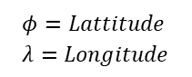
Optimisation Target
Costs as a form of mass that has to be devlivered to the lunar surface (similar to Equivilant System Mass)
Minimize total Costs
$$K_{Total}\left(t,φ,λ\right)= K_{fix,ISRU}(φ,λ)+K_{Transport}(φ,λ)∙t$$
$$φ=Lattitude \\ λ=Longitude$$
A
B
Location dependent spread comparison from A and B
„Breakeven“ when: spread A = spread B

Slide 4
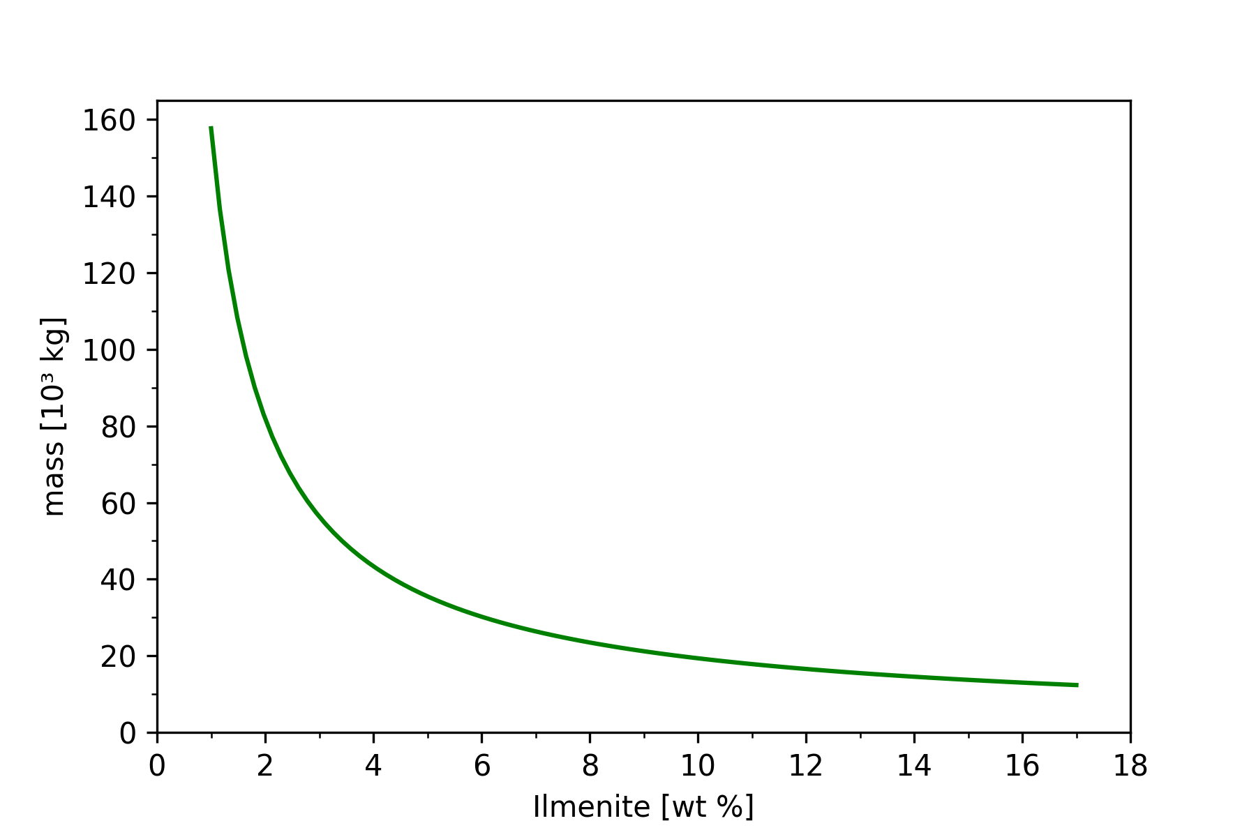
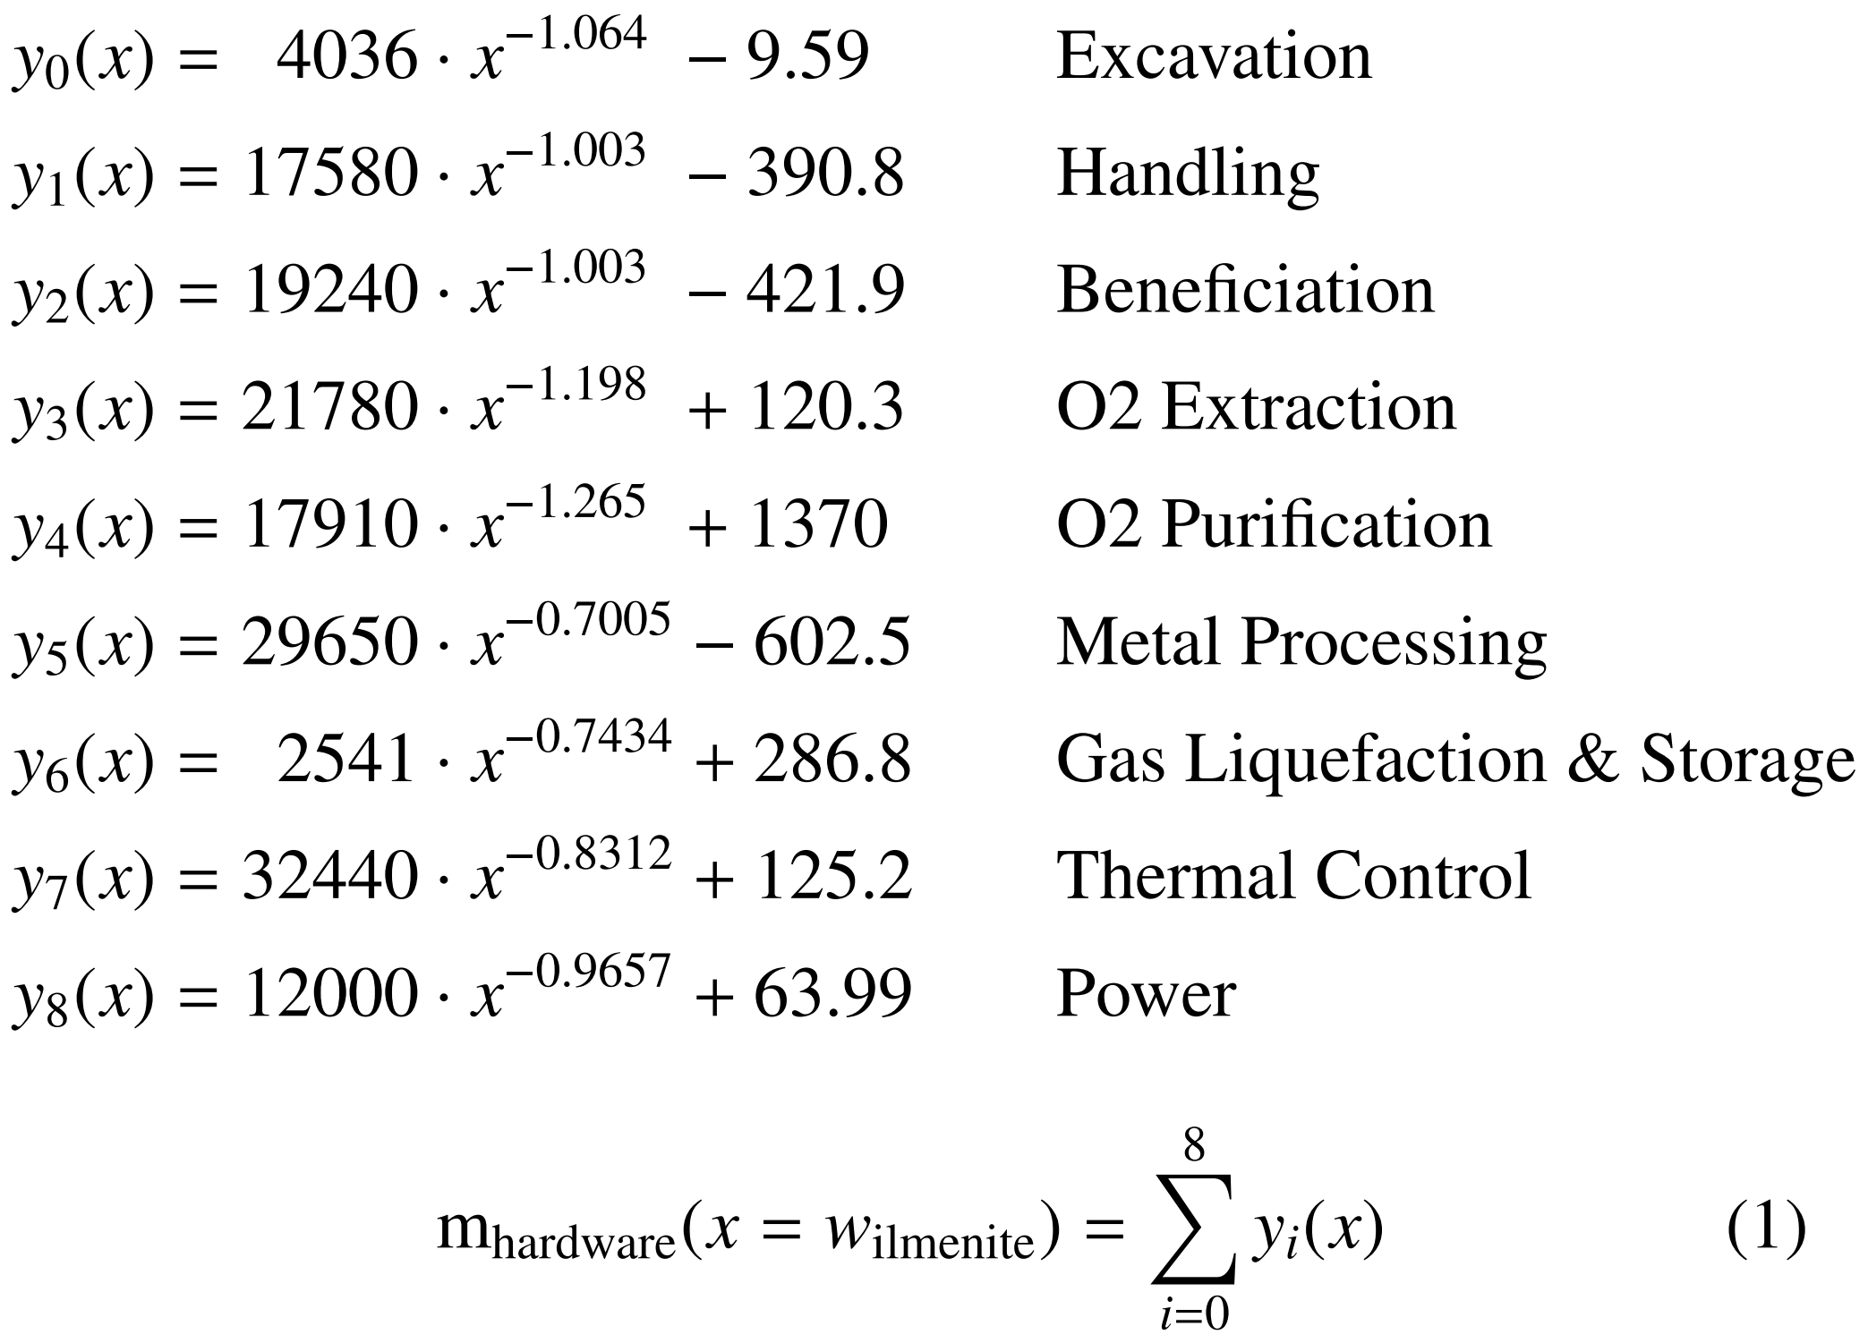
ISRU efficiency
A
Model for location dependencies of Ilmenit Reduction, Oxygen and Metal plant.
Ilmenit weight ratio of regolith considered
Solar irradiance, Temperature, Surface conditions, … not considered

Slide 5
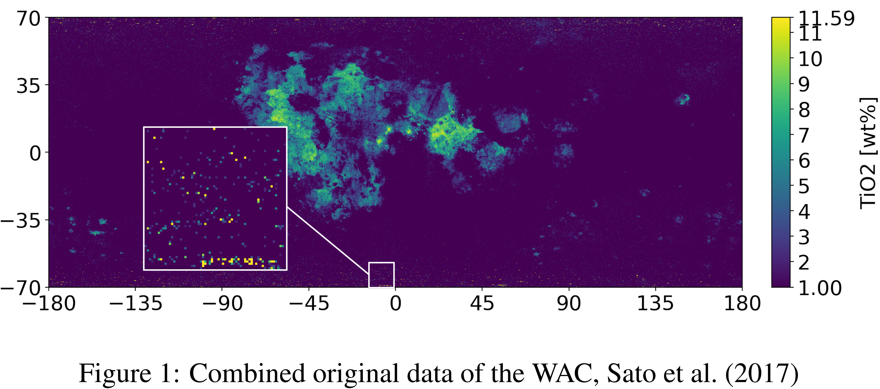
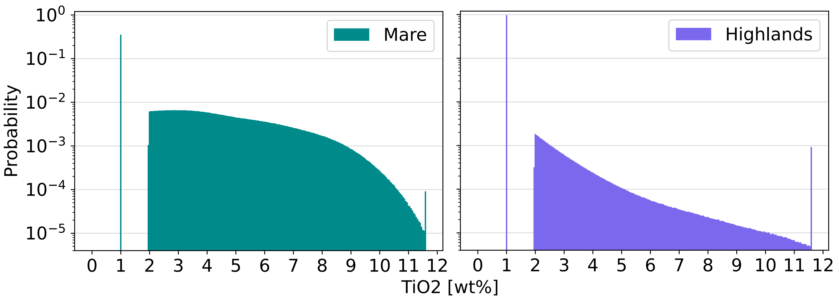
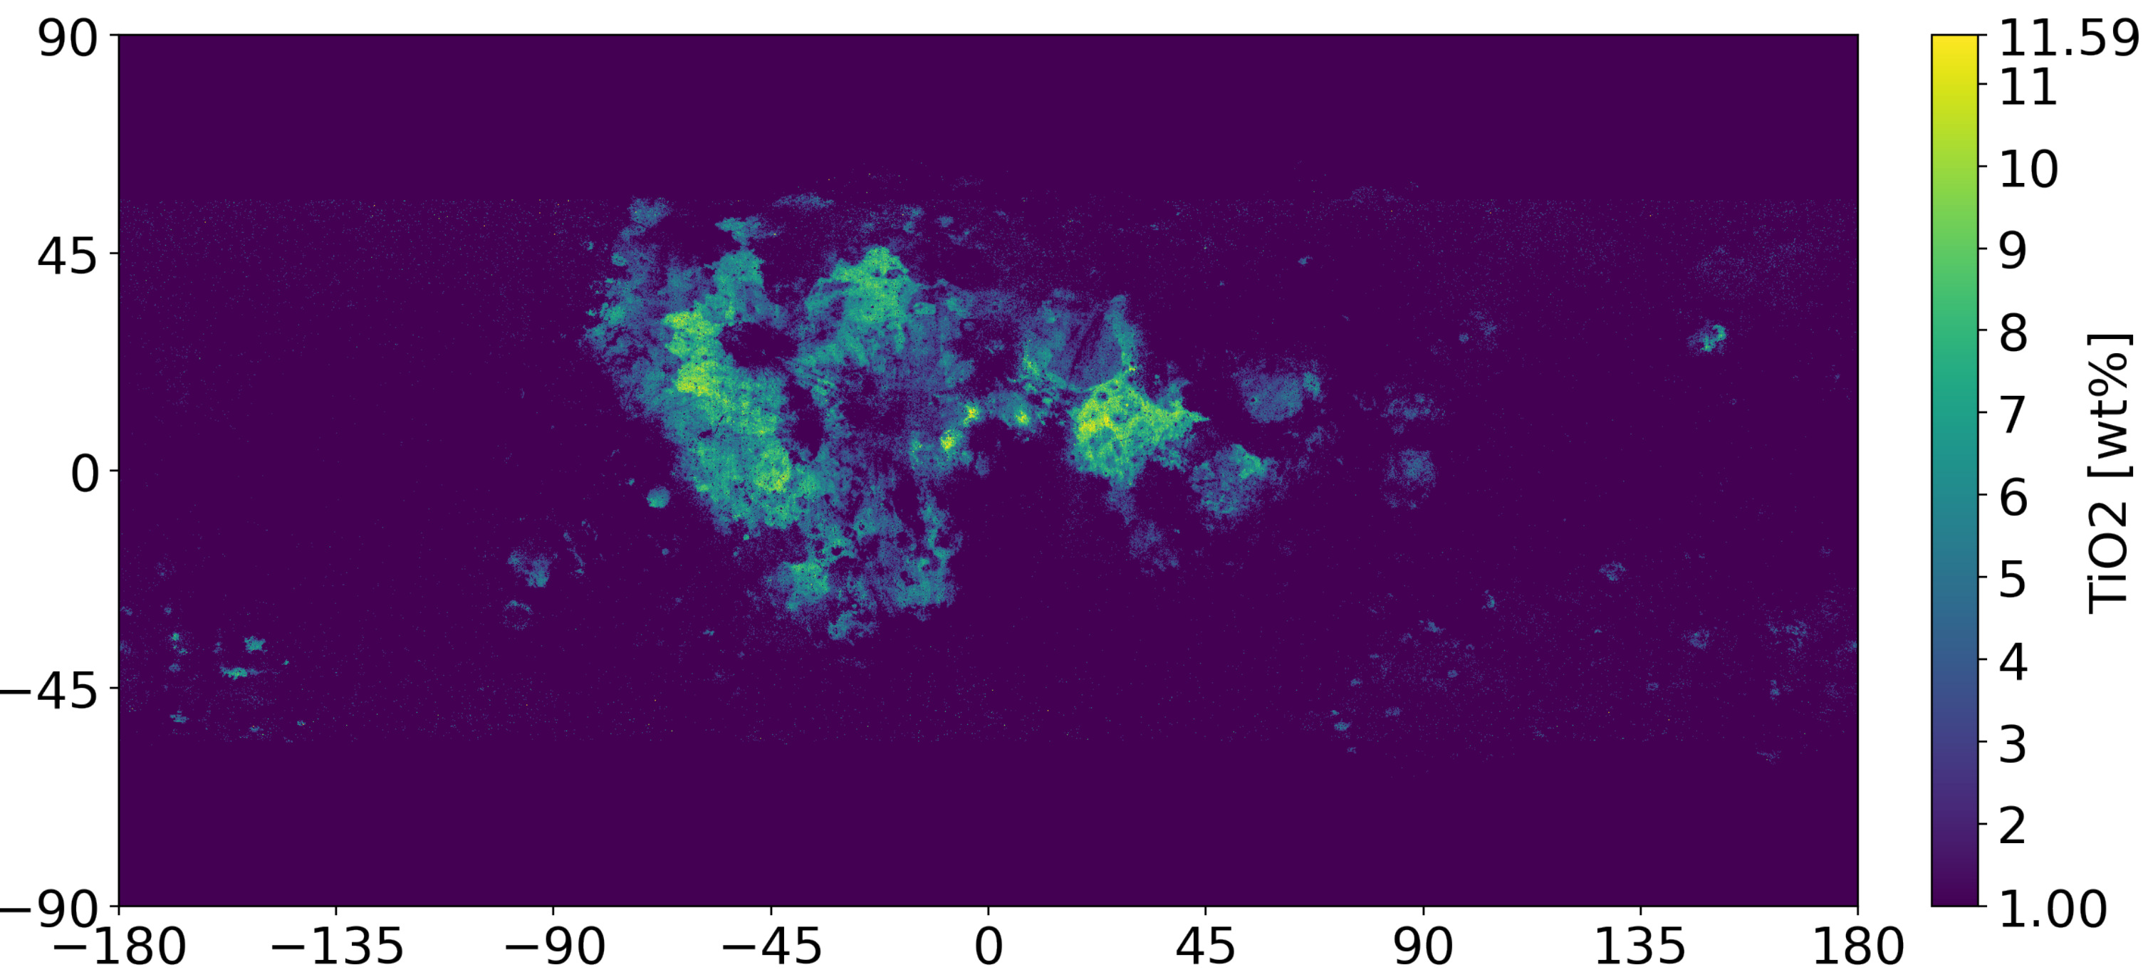
ISRU efficiency
A

Slide 6
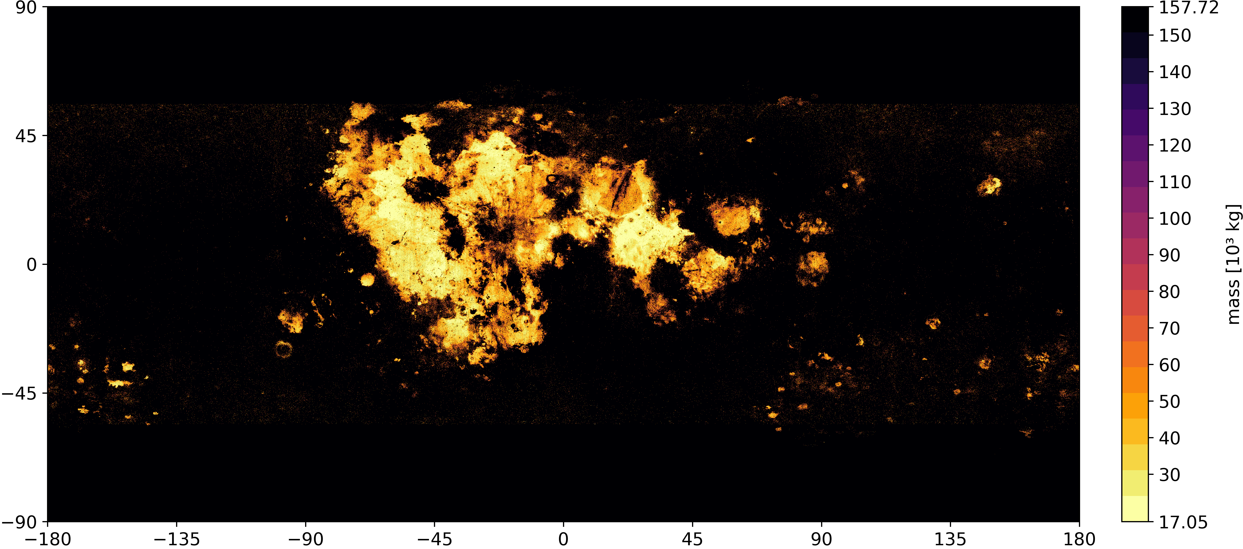
ISRU efficiency
A

Slide 7
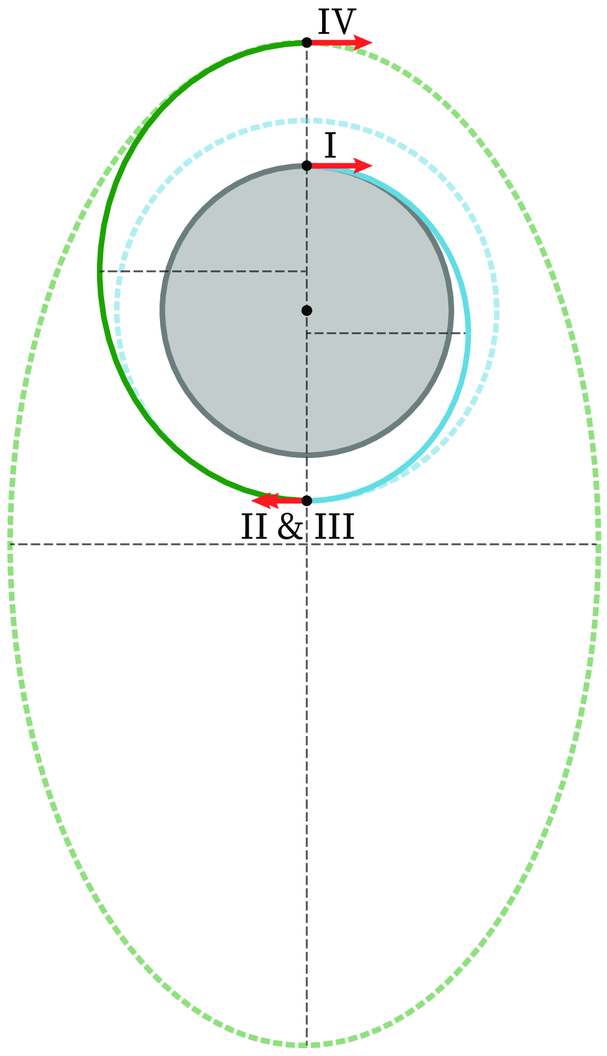
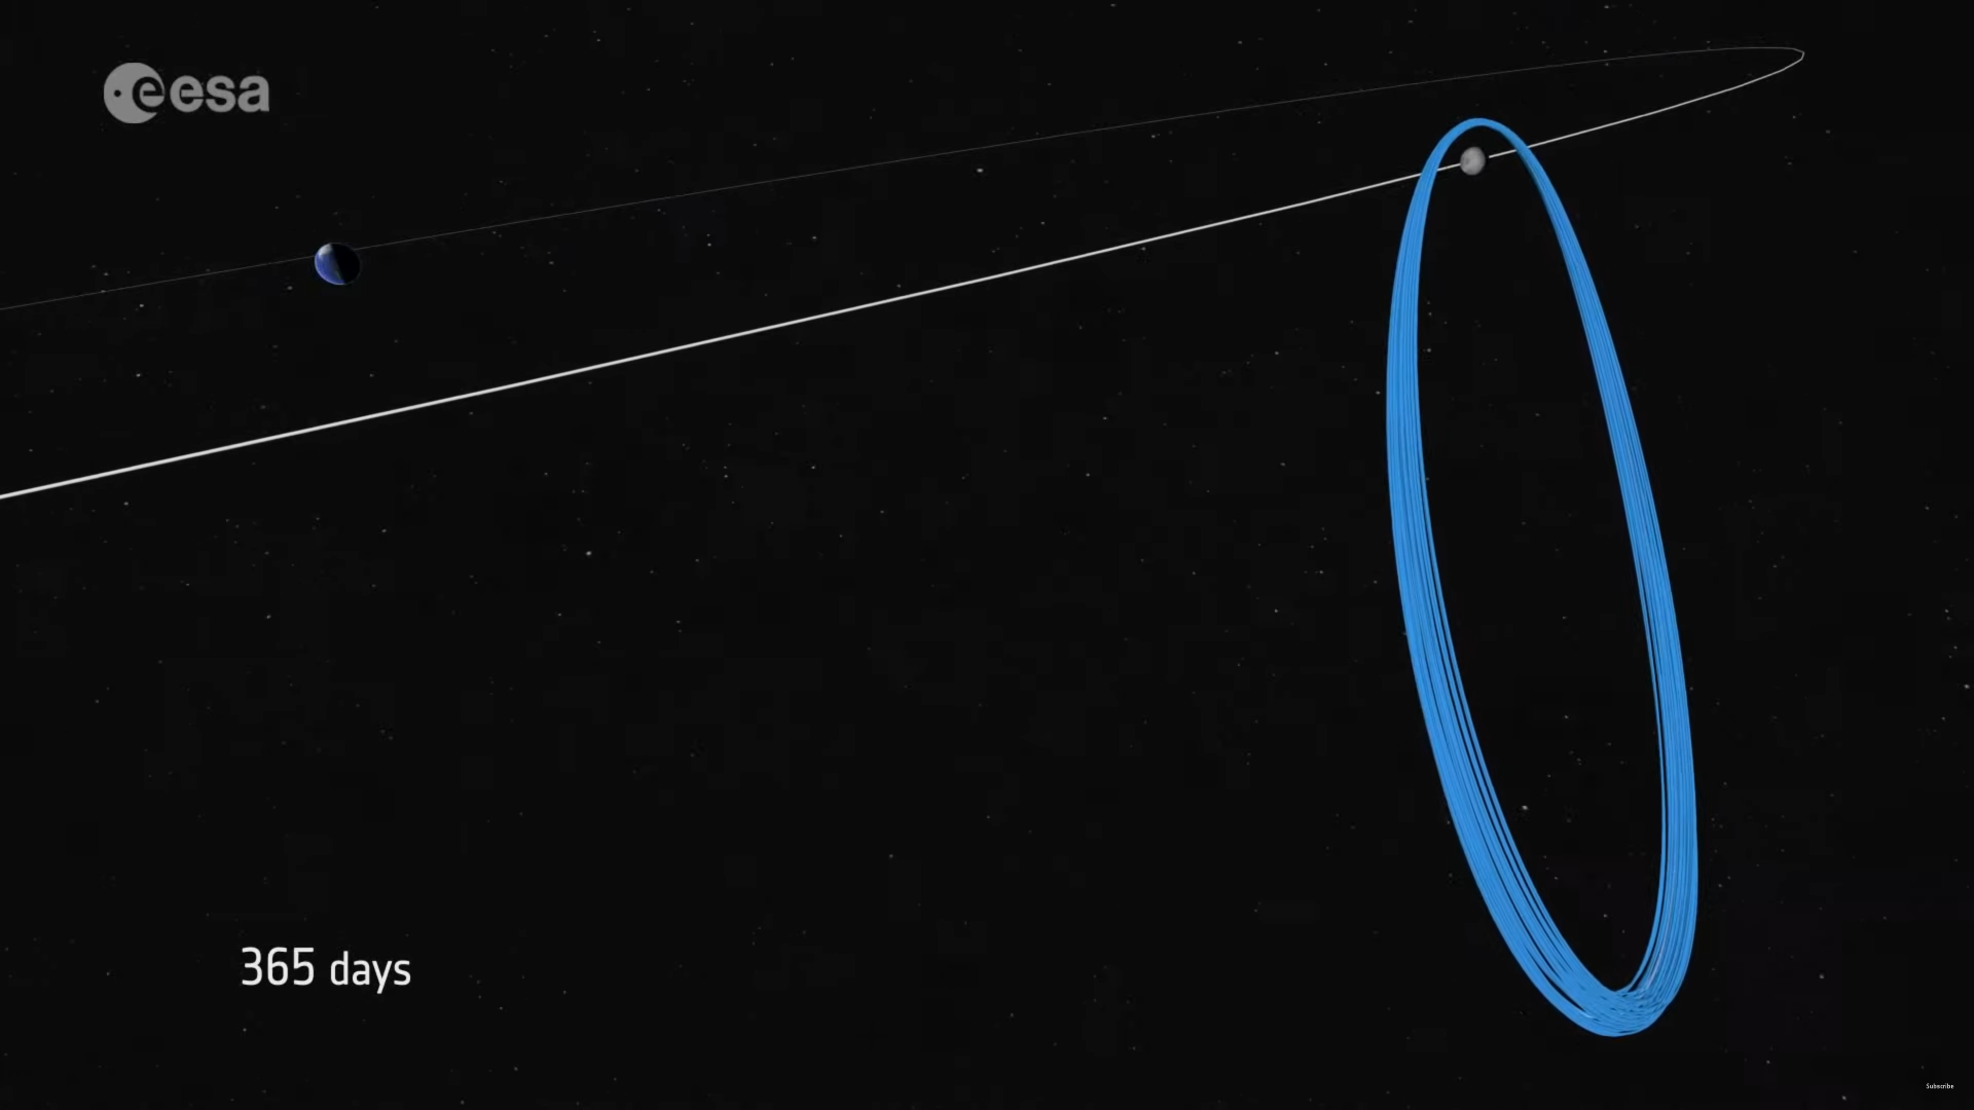
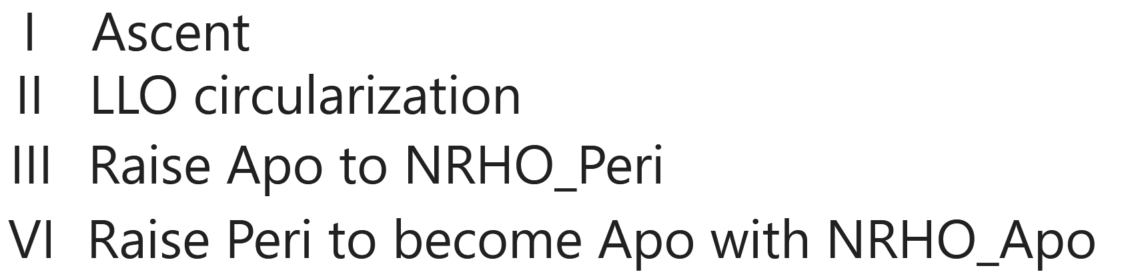
Transport efficiency
B
NRHO roughly matching normal orbit in Lunar fixed reference frame
Image: https://www.esa.int/ESA_Multimedia/Videos/2019/07/Angelic_halo_orbit_chosen_for_humankind_s_first_lunar_outpost
➔ Waiting in LLO until orbital plane lines up with NRHO
(Lunar obliquity neglected: 6.68° to 0°)

Slide 8
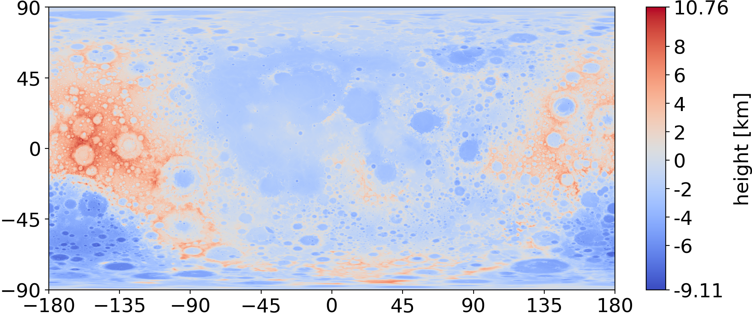
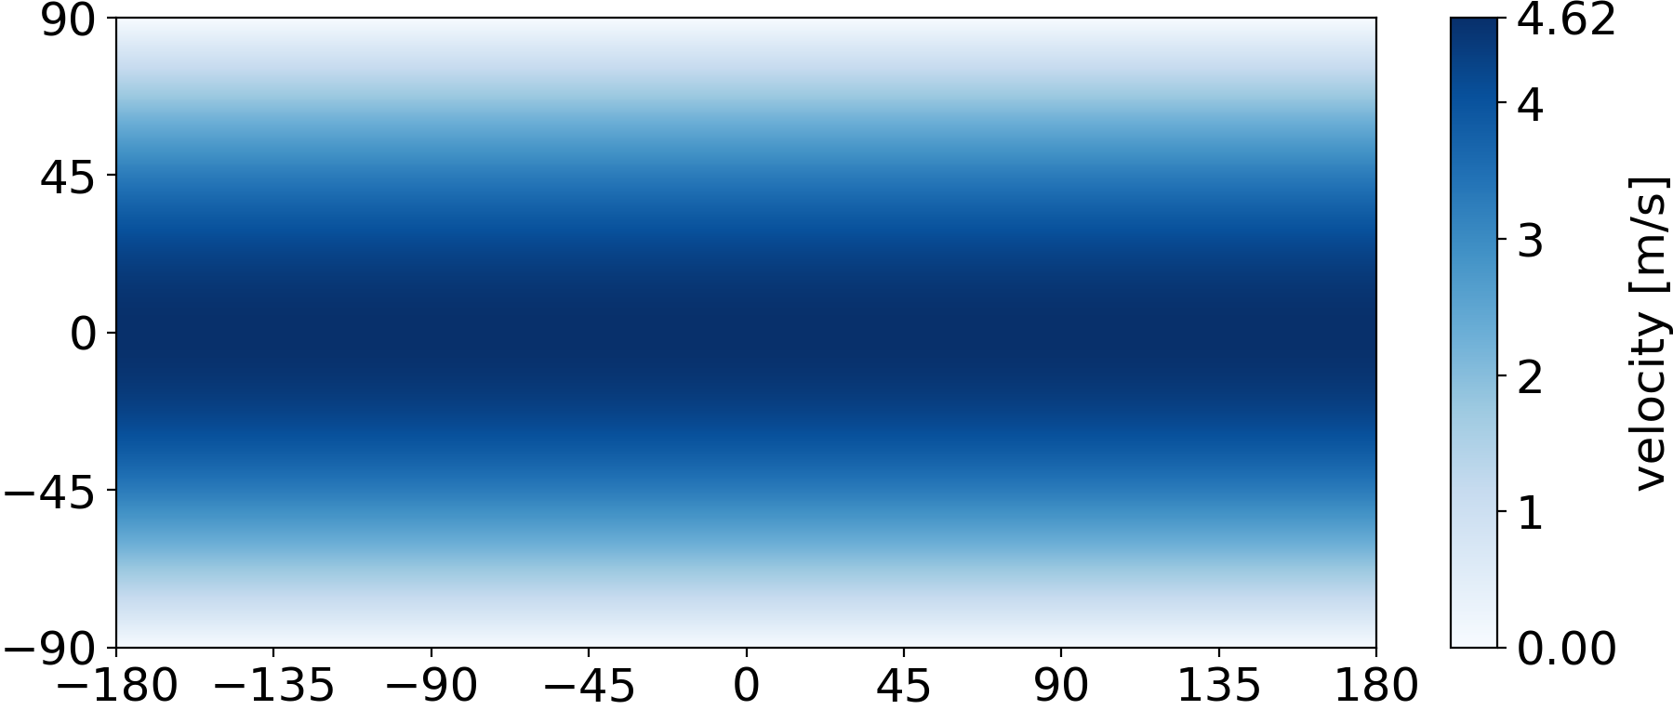
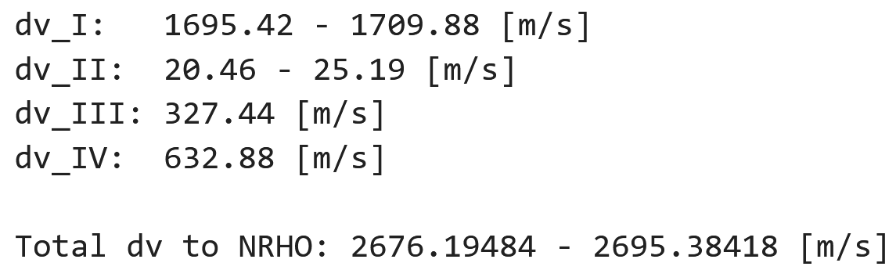
Transport efficiency
B
initial altitude / radius
initial ground speed

Slide 9
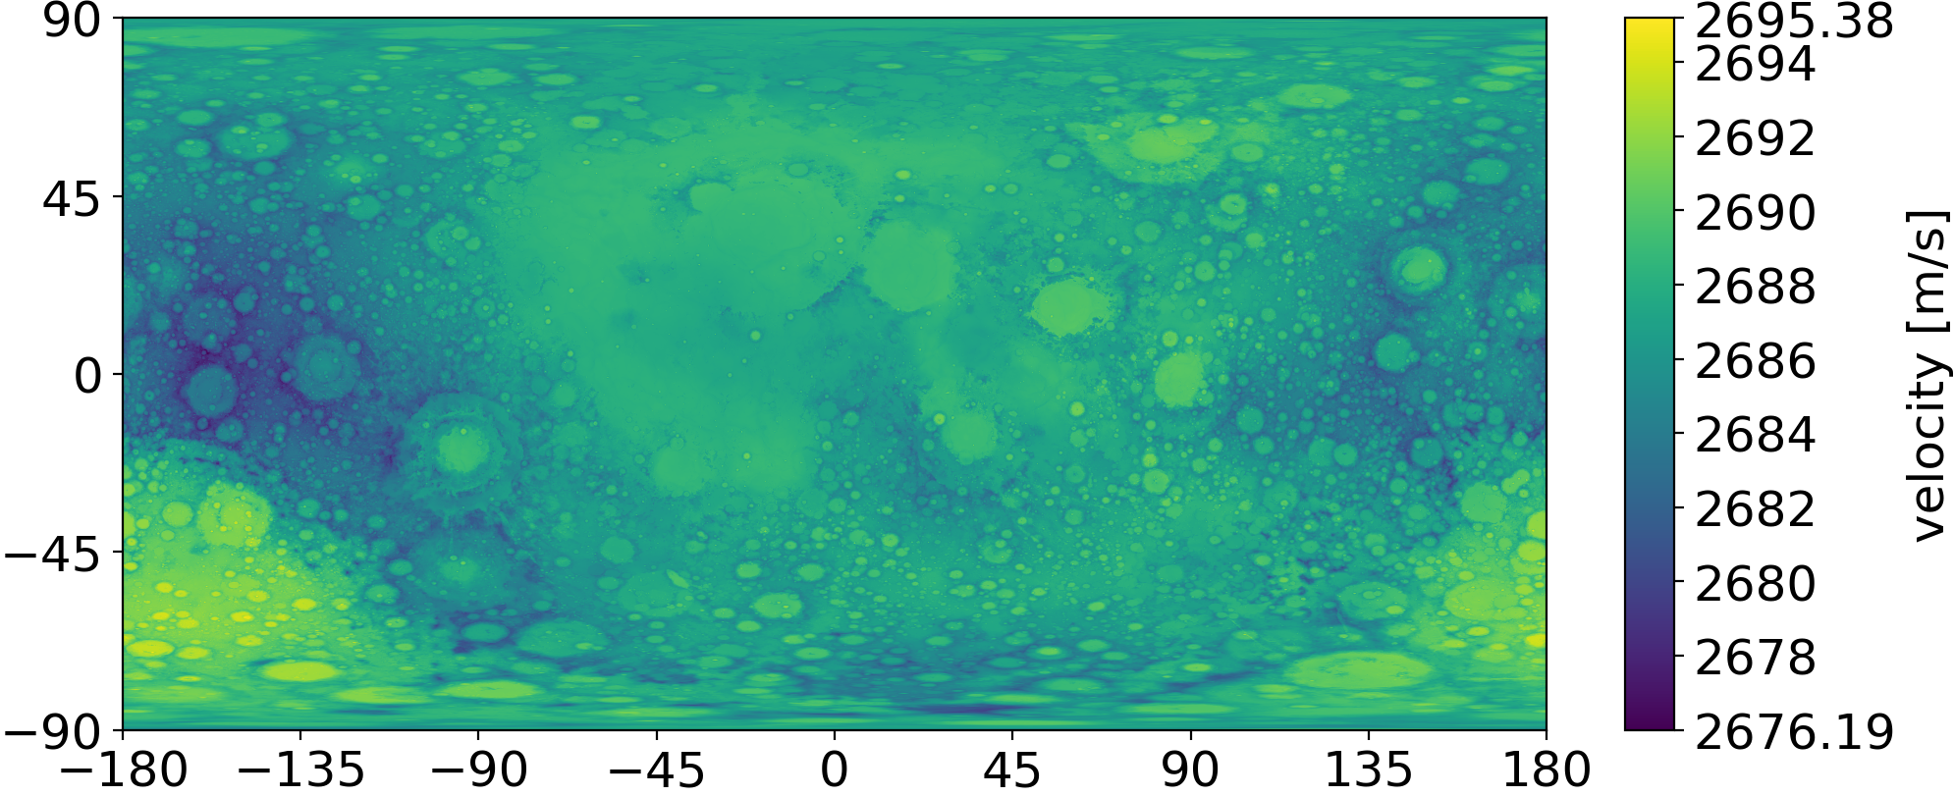
Transport efficiency
B
Global delta v map from lunar surface to the NRHO

Slide 10
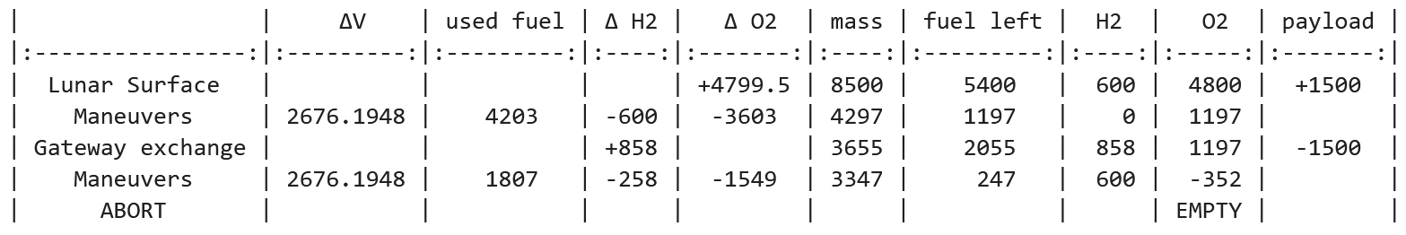
Transport efficiency
B
To be able to extrapolate from delta v to mass costs
➔ Launcher has to be designed
Starting point: EL3 (European Large Logistics Lander)
Assumed values: Oxygen, Hydrogen, o/f ratio, isp
Standard EL3 is unable to carry out the mission
➔ upscaling

Slide 11
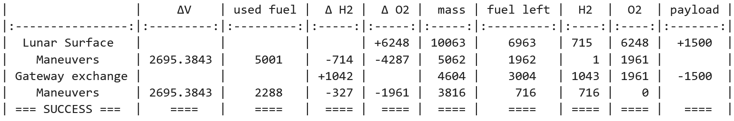
Transport efficiency
B
upscale: increased wet mass with constant dry mass
➔ effectively increasing mass ratio
Iterative solving to converge a launcher for a given payload and delta v
In this case: +1500 kg O2, -1042 kg H2

Slide 12
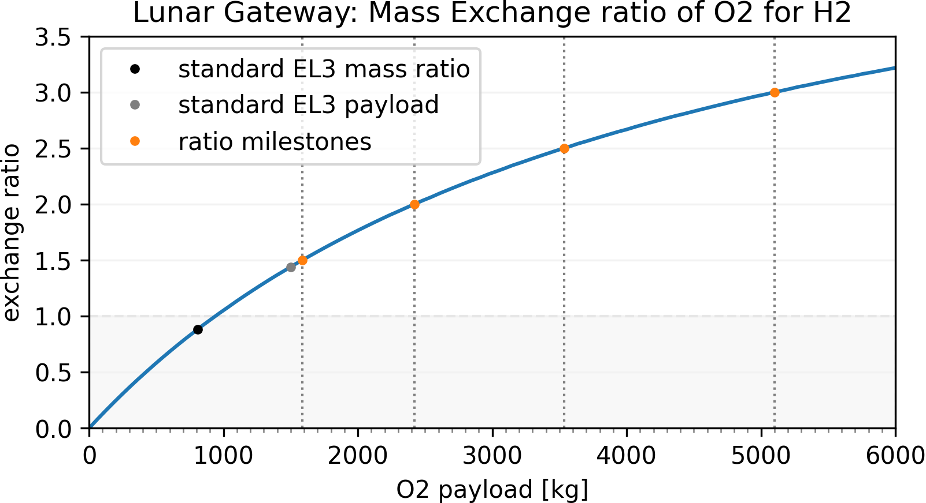
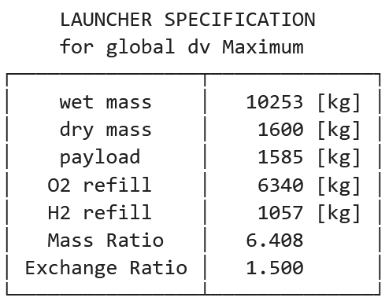
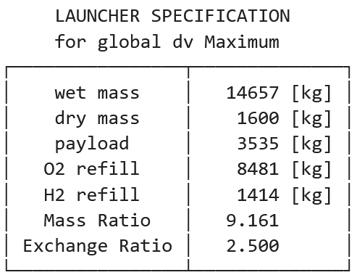
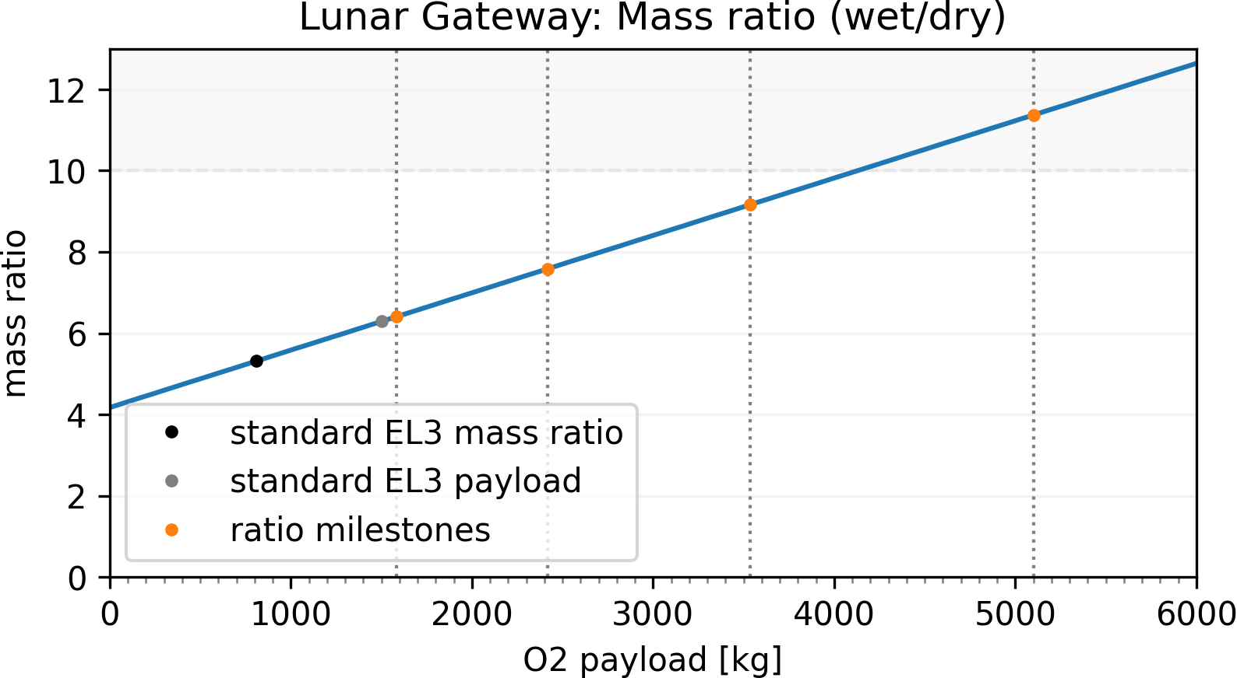
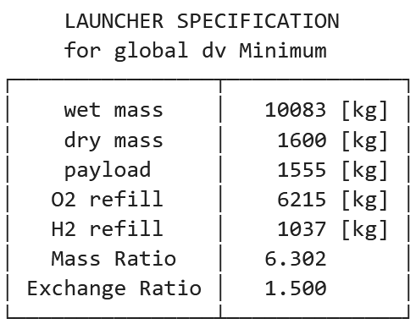
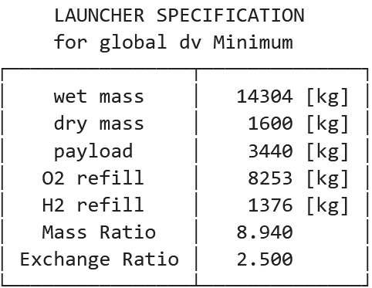
Transport efficiency
B
exchange ratio = 1.5
exchange ratio = 2.5

Slide 13
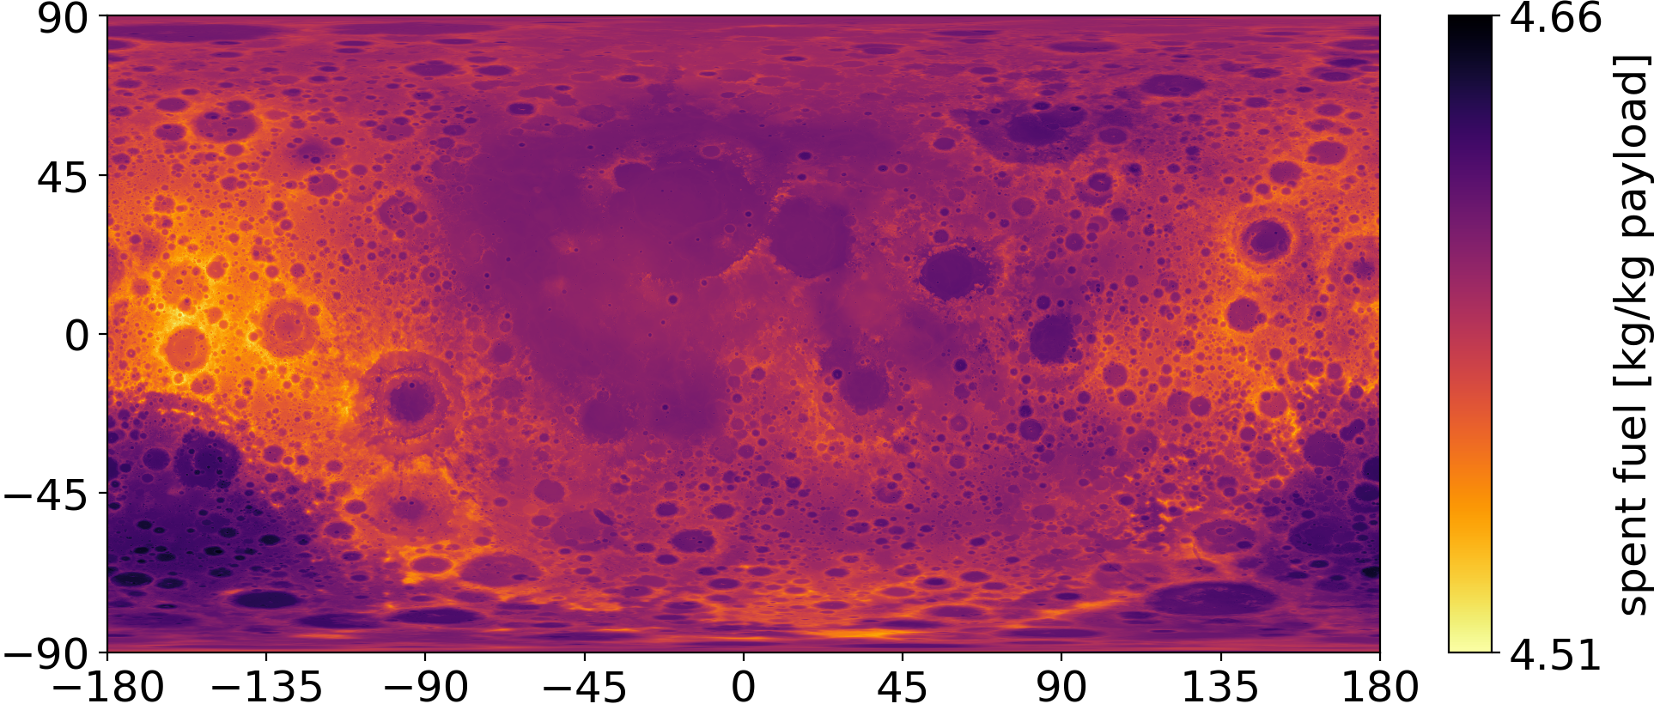
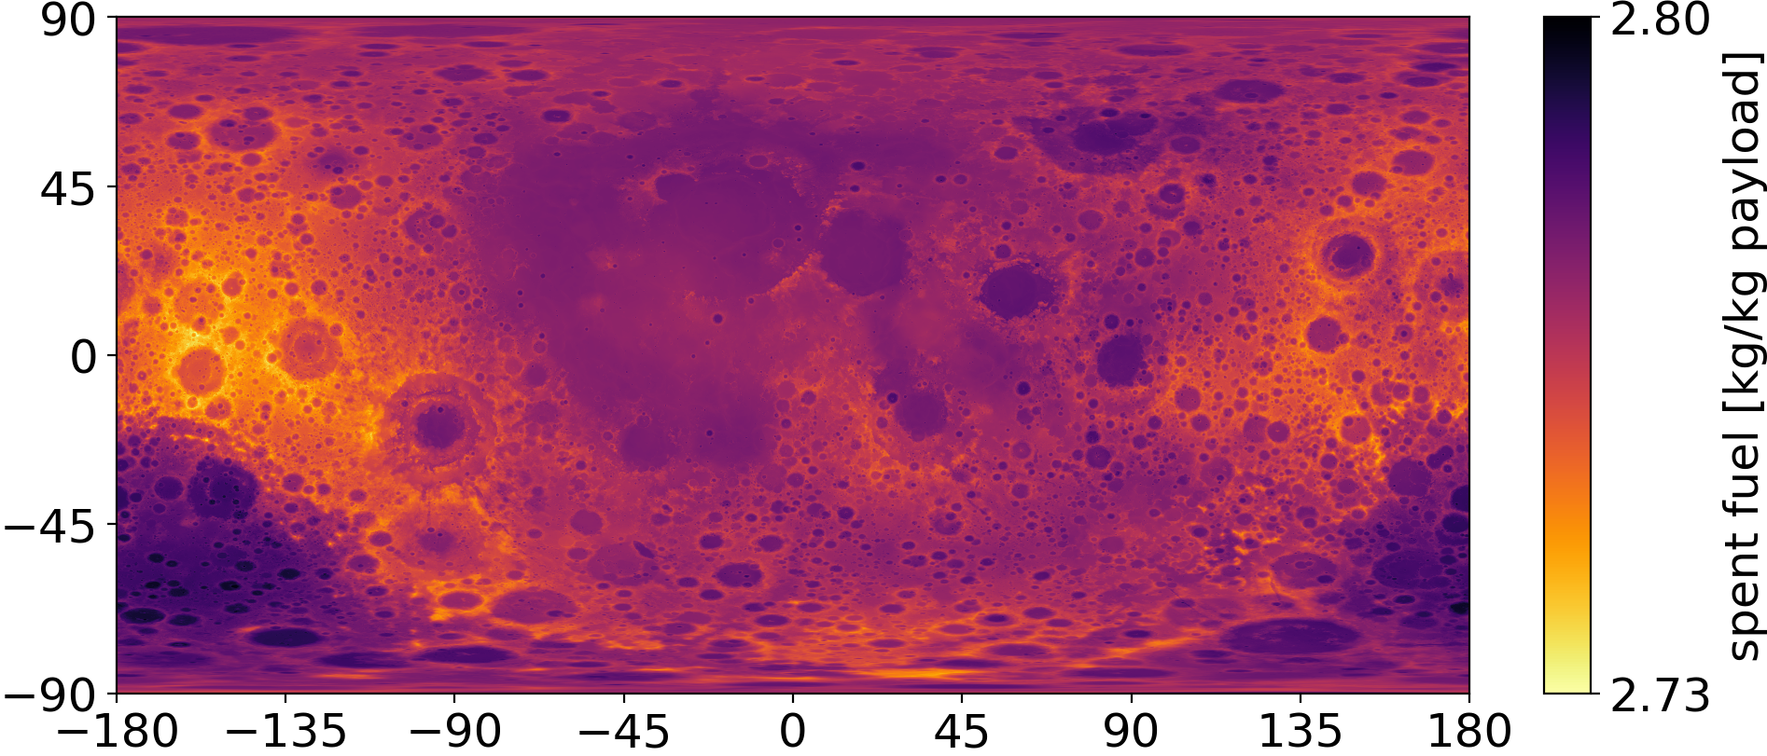
Transport efficiency
B
exchange ratio = 1.5
➔ spent fuel per kg payload
exchange ratio = 2.5

Slide 14
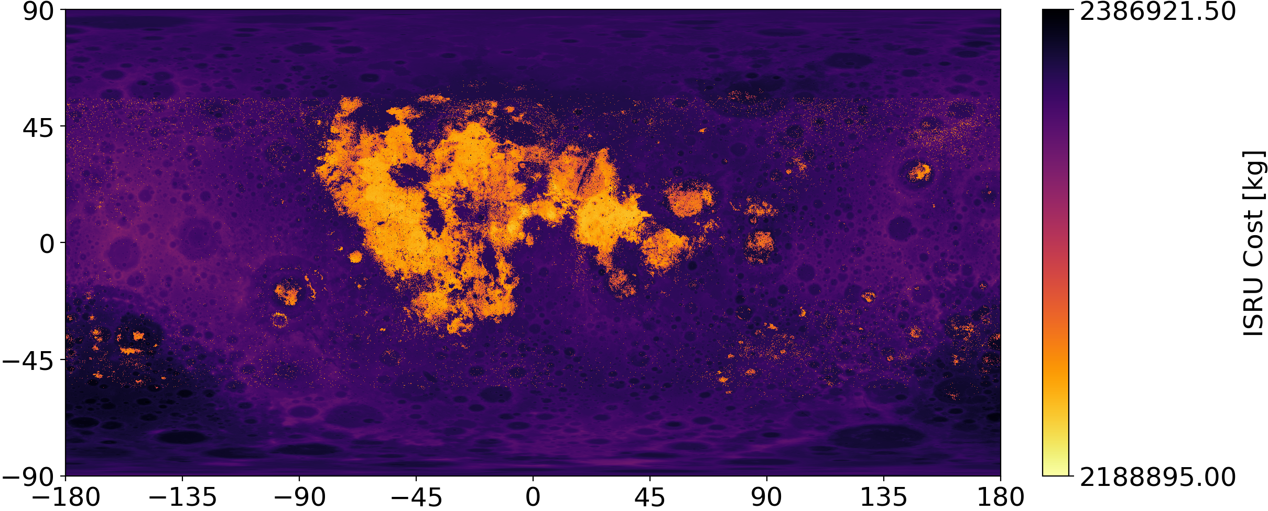
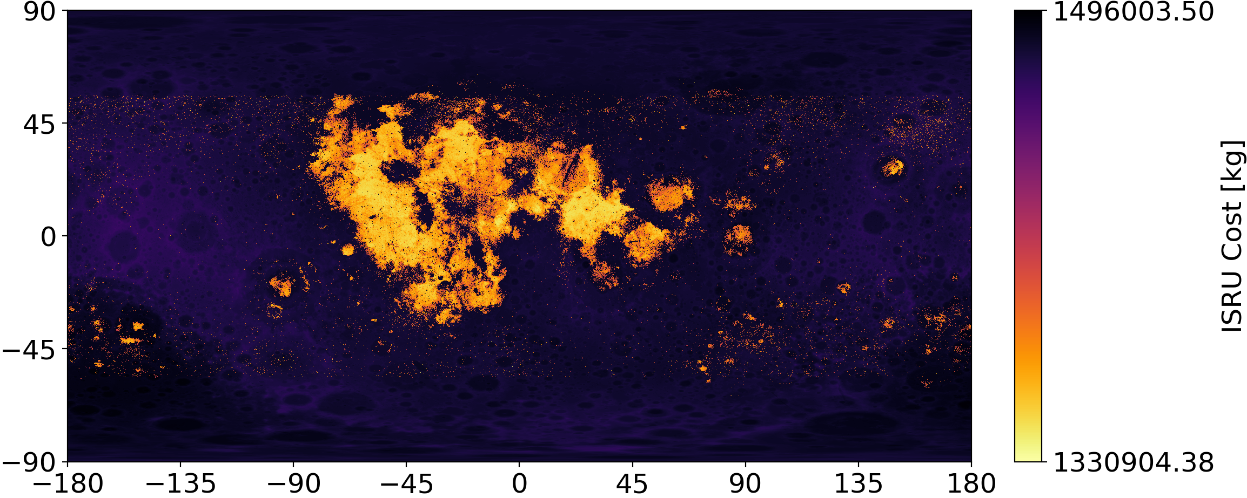
Total efficiency
C
Influence in the first 20 years
Simple: all spent fuel is mass cost
exchange ratio = 1.5
exchange ratio = 2.5

Slide 15
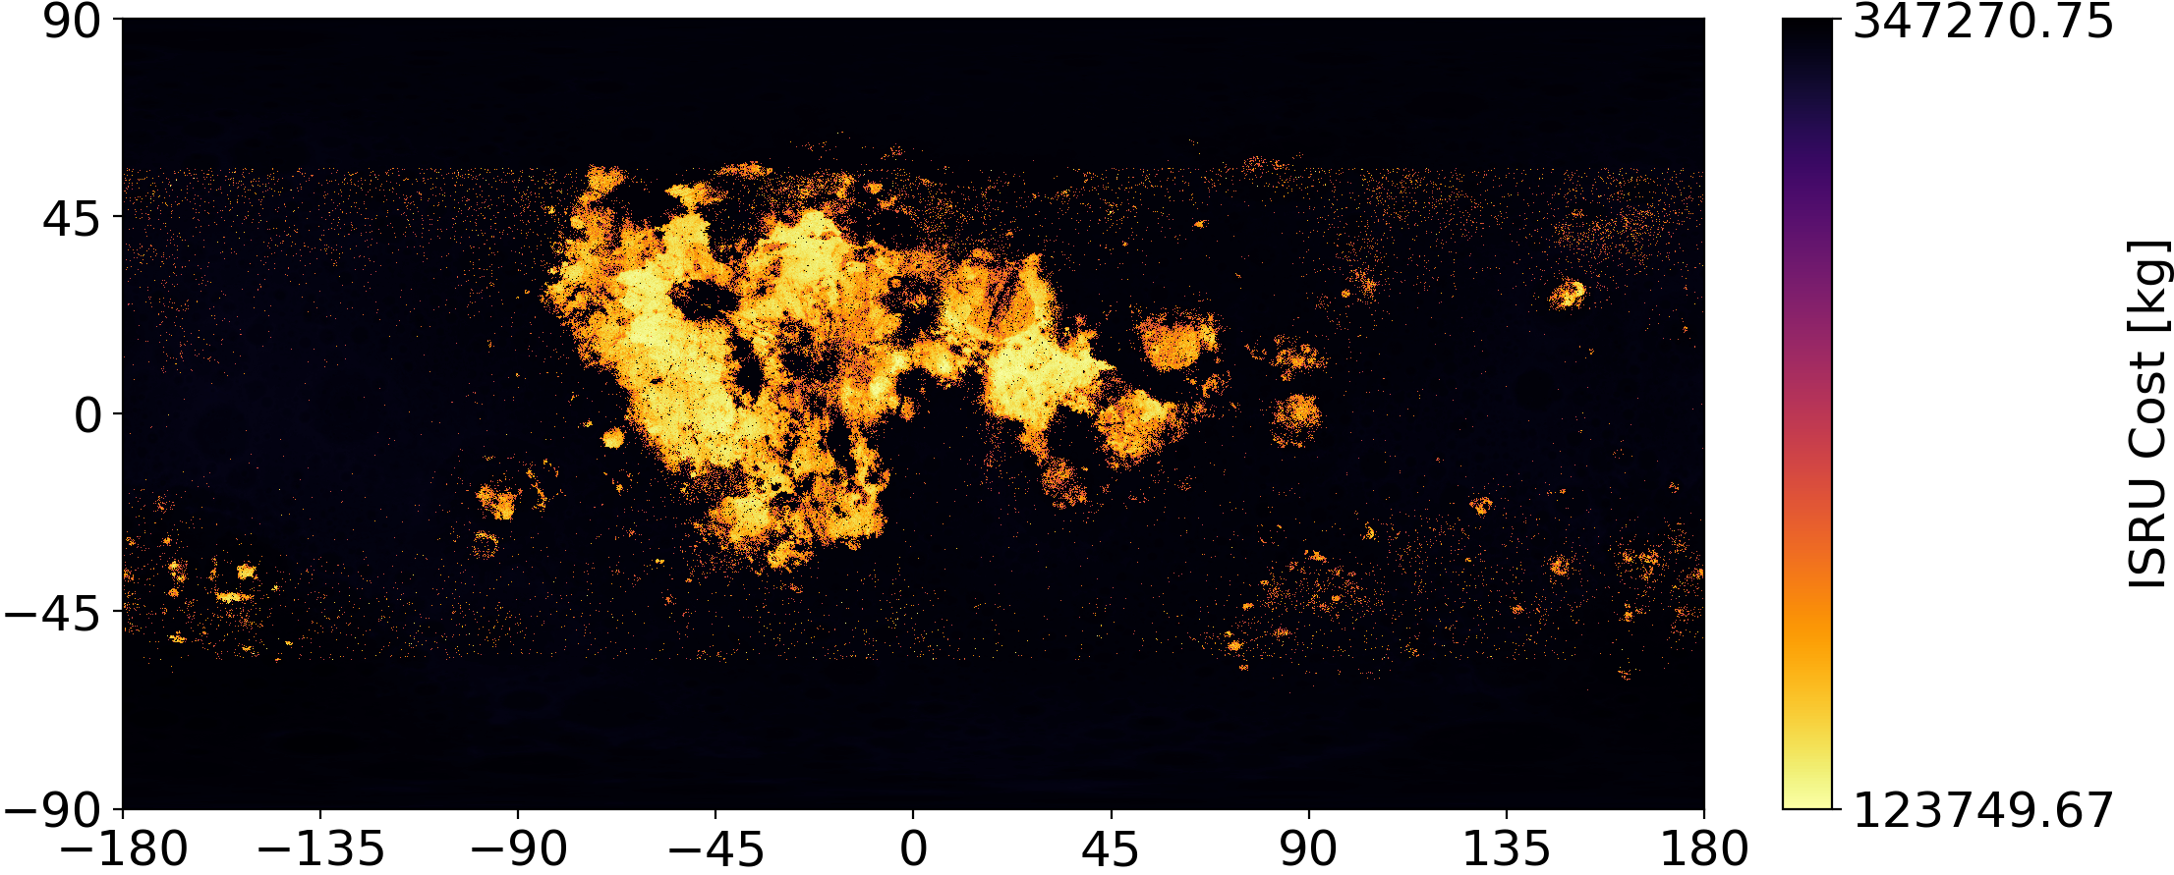

Total efficiency
C
Influence in the first 20 years
Advanced: only Hydrogen is mass cost + additional ISRU cost for Oxygen spent
exchange ratio = 1.5
exchange ratio = 2.5

Slide 16
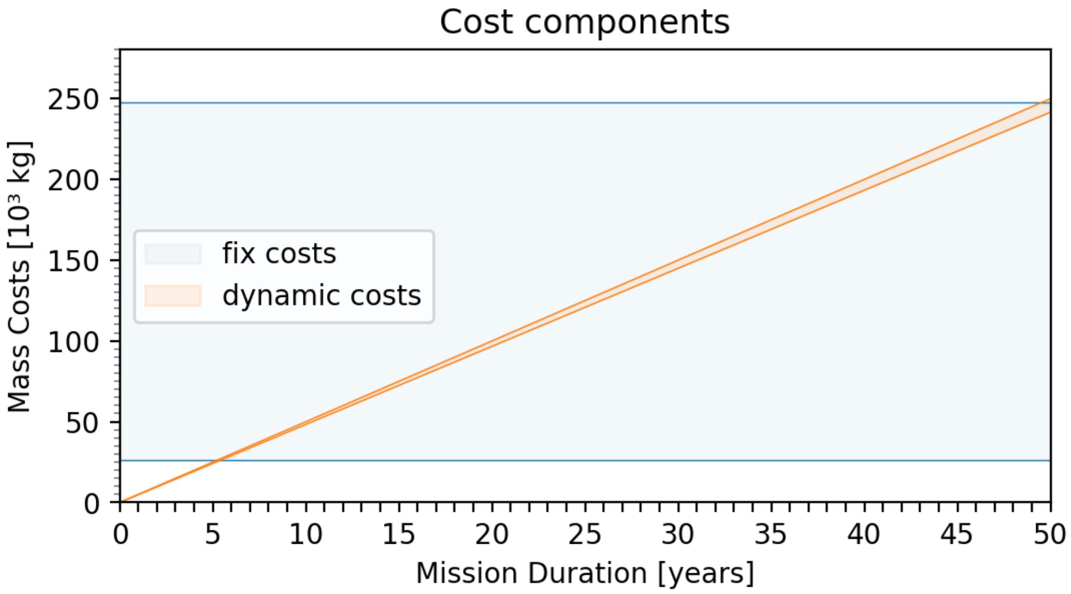
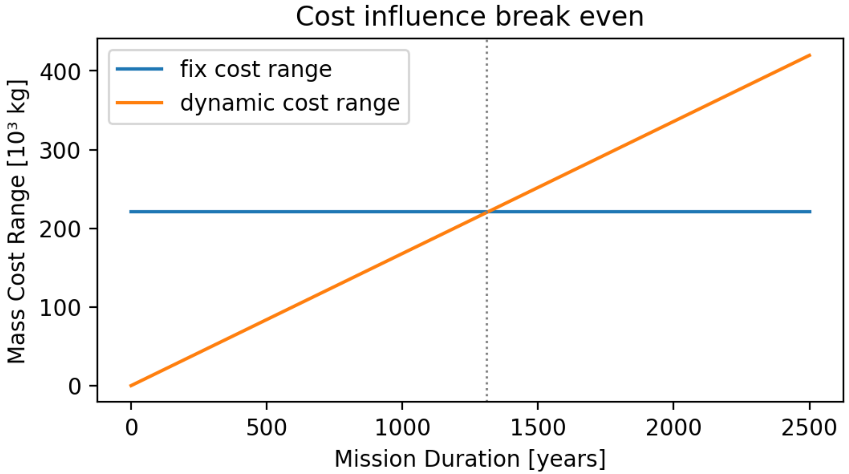
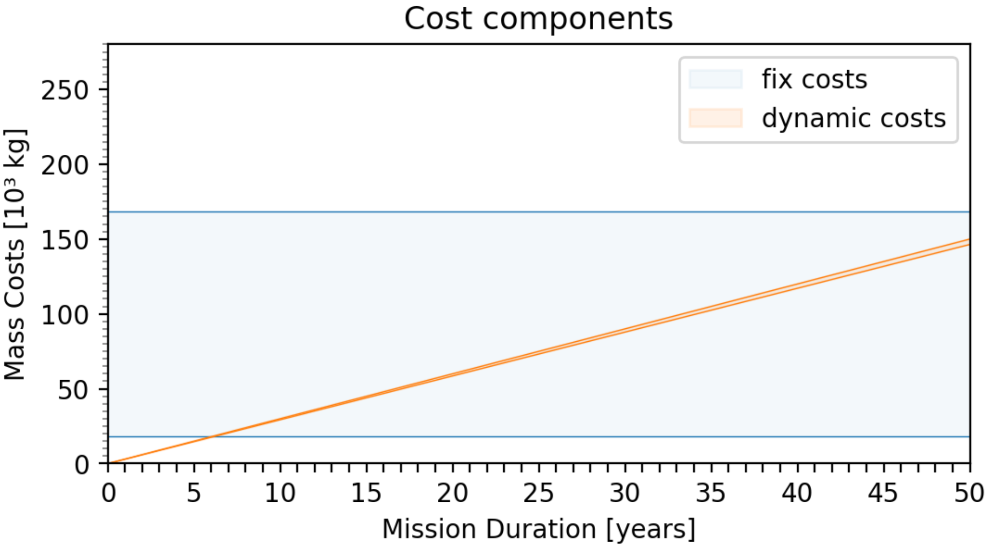
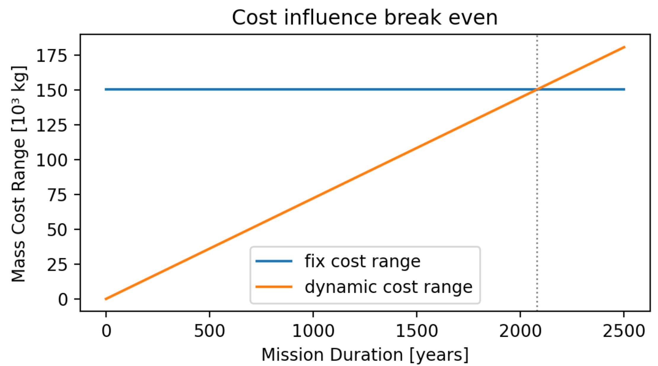
Total efficiency
C
exchange ratio = 1.5
exchange ratio = 2.5

Slide 17
Take Away
Flight Cost differences to the Lunar Gateway can be neglected for Ilmenite Reduction
Break Even Locational Sensitivity – minimum ISRU sensitivity to neglect Flight Cost differences

